Slide 1
Project Lombok in Java and How to get started?
Java is a very popular language, but it has few drawbacks. One of the most popular drawbacks is that we still need to write the boilerplate codes like getters, setters, toString method in Java whereas Kotlin and Scala, which are also JVM based don’t need so and hence, this is the reason for their increased popularity in the community. This is where Lombok comes into the picture and overcomes this drawback of Java.
Project Lombok is a java library tool that is used to minimize/remove the boilerplate code and save the precious time of developers during development by just using some annotations. In addition to it, it also increases the readability of the source code and saves space. But you might be thinking that nowadays, everyone uses IDEs which provides an option for generating these boilerplate codes, then what is the use of Lombok. Whenever we use IDEs to generate these boilerplate codes, we just save ourselves from writing all these codes but it is actually present in our source code and increases the LOC (lines of code), and reduces maintainability and readability. On the other hand, Lombok adds all these boilerplate codes at the compile-time in the “.class” file and not in our source code.

Slide 2
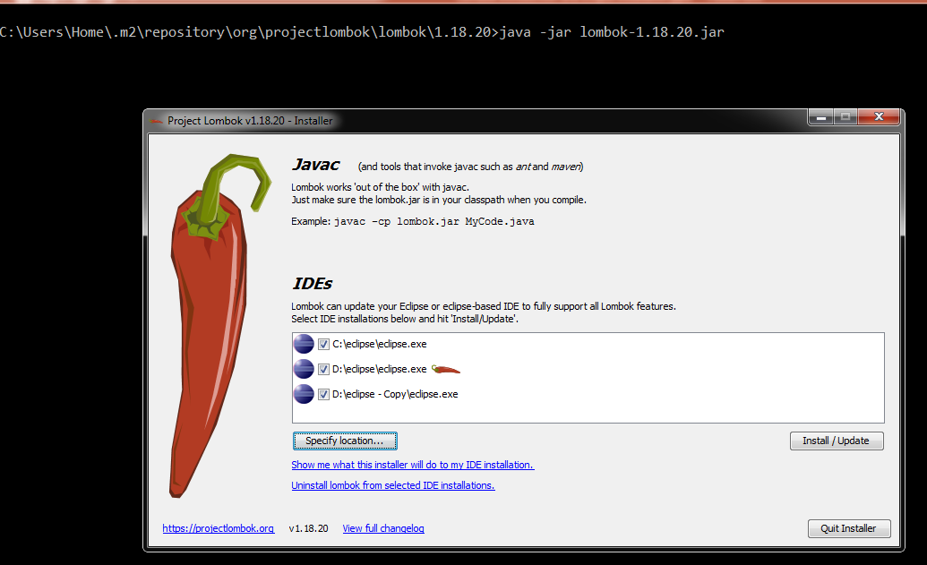
Project Lombok in Java and How to get started?
java -jar lombok-1.18.20.jar

Slide 3
Project Lombok in Java and How to get started?
Most frequently used annotations of Lombok
@Getter and @Setter: These annotations provide the getter and setter methods for a field. These annotations can be used at both the levels, field as well as class
@NoArgsConstructor: This annotation is used to generate a constructor with no arguments. It has an empty body and does nothing.
@AllArgsConstructor: This annotation is used to generate a parameterized constructor which accepts a single parameter for each field and initializes them using it. It is required when you want to generate an object of the class by passing the initial values of the fields in the constructor.
@ToString: This annotation is used to override the toString() method and generate a default implementation for it. The default implementation prints the class name and the fields in order, separated by commas. You can also skip some fields that you don’t want to print by annotating them with @ToString.Exclude.
@EqualsAndHashCode: This annotation is used to override the equals() and hashCode() methods and provides a default implementation for it. The default implementation uses all the non-static fields, and we can modify it and can exclude some fields using the annotation @EqualsAndHashCode.Exclude.
@Data: This annotation is a shortcut annotation and bundles @ToString, @Getter, @Setter, @EqualsAndHashCode and @RequiredArgsConstructor annotations into a single annotation. This annotation provides all the normally used boilerplate code in the model classes of java like getters for all the fields, setter for all the non-final fields, a default implementation for toString(), equals() and hashCode() using all the fields of the class and a constructor that initializes all the fields of the class.

Slide 4
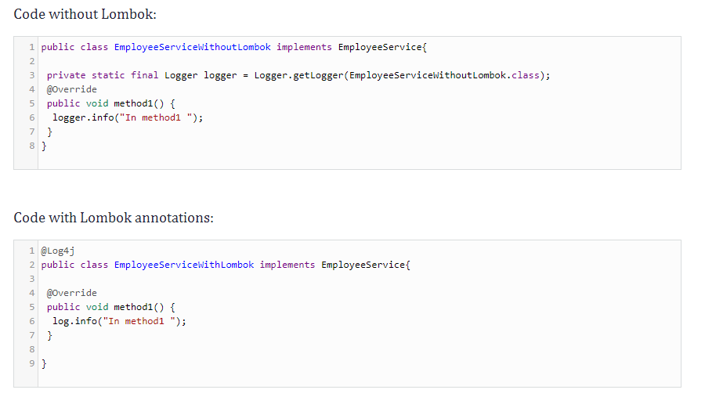
Project Lombok in Java and How to get started?
@Log4j, @Slf4j
These annotations are used to generate code related to the logger, as demonstrated in the following example.

Slide 5
Project Lombok in Java and How to get started?
Delomboking – Rollback Lombok from Project
Think about this scenario where you had decided to take advantage of Lombok and already added lots of annotations and suddenly due to some change in the decision-makers in the project, you have been asked to stop using Lombok and need to go with the old way of doing things.
Now it would not be a easy task at all to revert all the annotations that has been added with the boilerplate code. To do that Lombok itself has provided some steps, by which we can easily replace the annotated source code by the Lombok generated classes.
java -jar lombok-1.18.20.jar delombok src -d src-delomboked

